Slide 1

Product Detail Page Conversion Optimization Experiments
Business Team presentation

Slide 2
Disclaimer
This presentation uses adjusted figures for confidentiality purposes.
Analytical approach and insights remain directionally accurate.

Slide 3
Agenda
Problem statement:
Sticky Add-to-Cart on PDP
Photo Grid improvement on PDP
Current Layout & Proposed Variations
Hypothesis & Success metrics
Test Design & Experiment Setup
Results
Conclusions
Next Steps

Slide 4
Sticky Add-to-Cart on PDP

Slide 5
Sticky Add-to-Cart on PDP - Problem statement
Business context
Product Detail Pages (PDPs) drive 70% of traffic, but only 4% of visitors add-to-cart
Improving on-page conversion is a priority to unlock incremental revenue without additional spend
Leadership question
Does making the add-to-cart (ATC) button persistently visible reduce purchase friction and increase add-to-cart conversion on PDPs?
Decisions to be made
Should we roll out a sticky add-to-cart component across PDPs?
should it be deployed universally or targeted to specific devices?

Slide 6
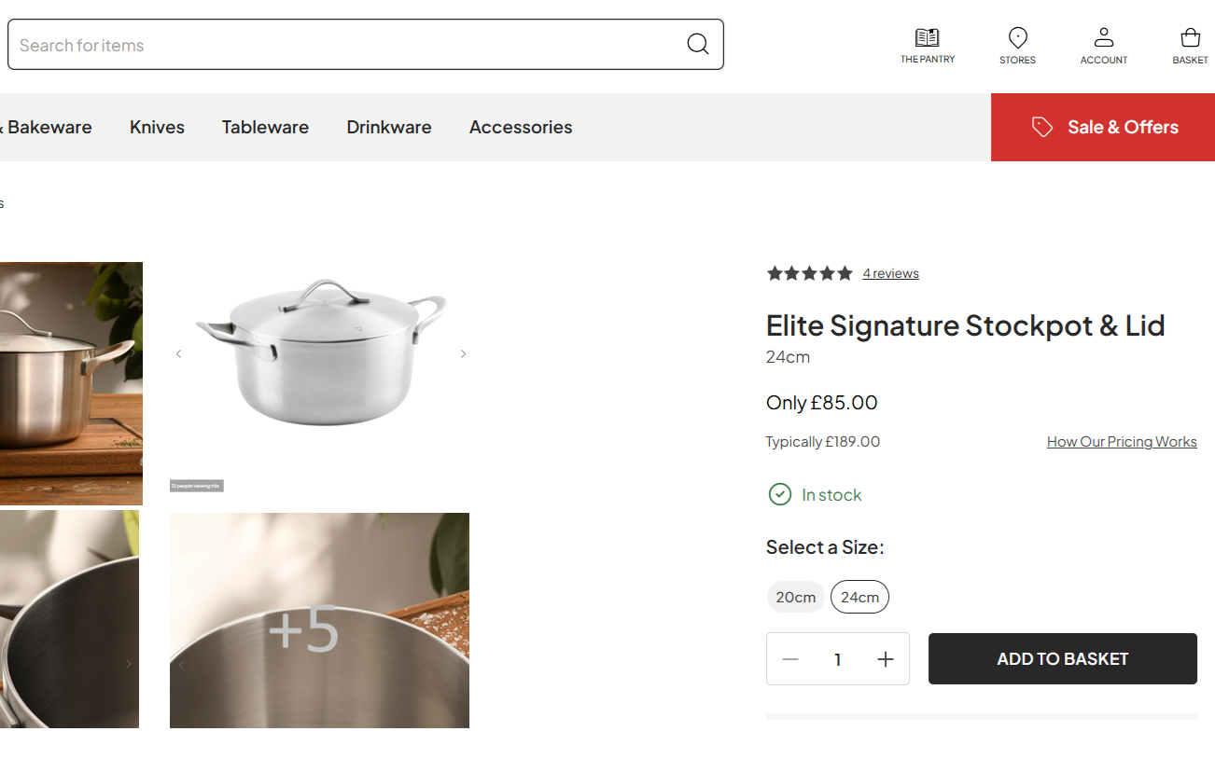
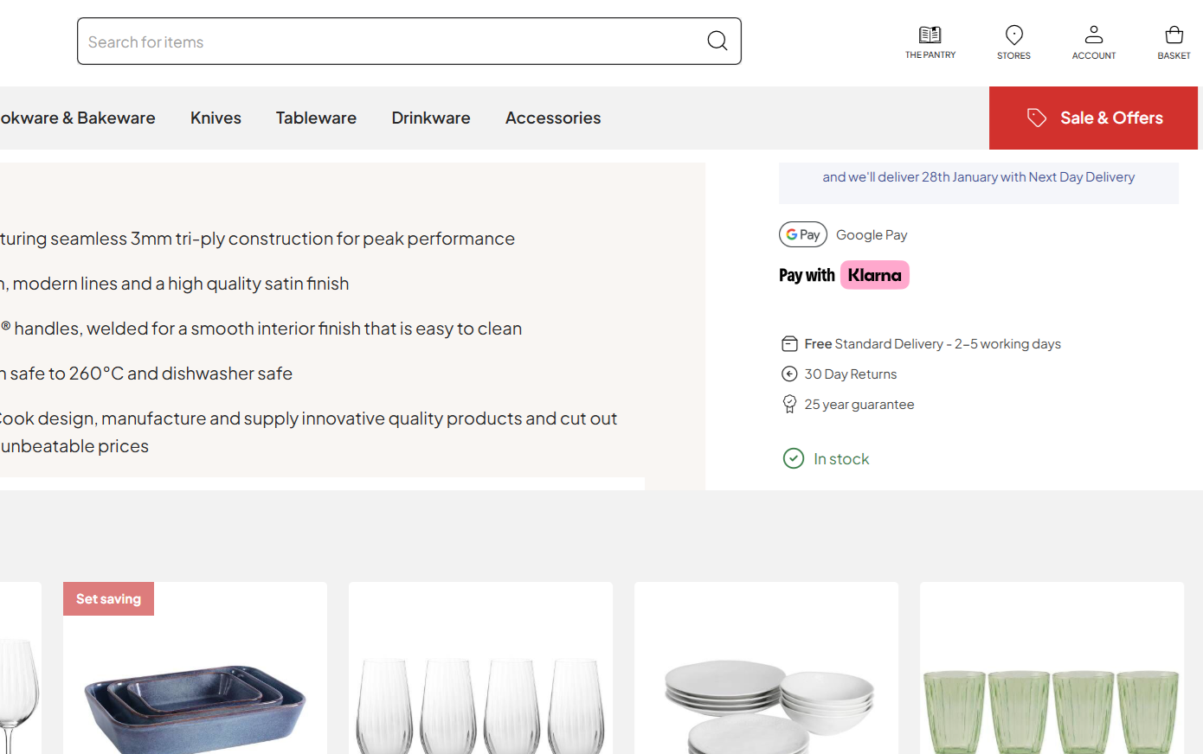
Sticky Add-to-Cart on PDP – Current Layout
View on Page Load View after Scrolling
ATC is visible

Slide 7
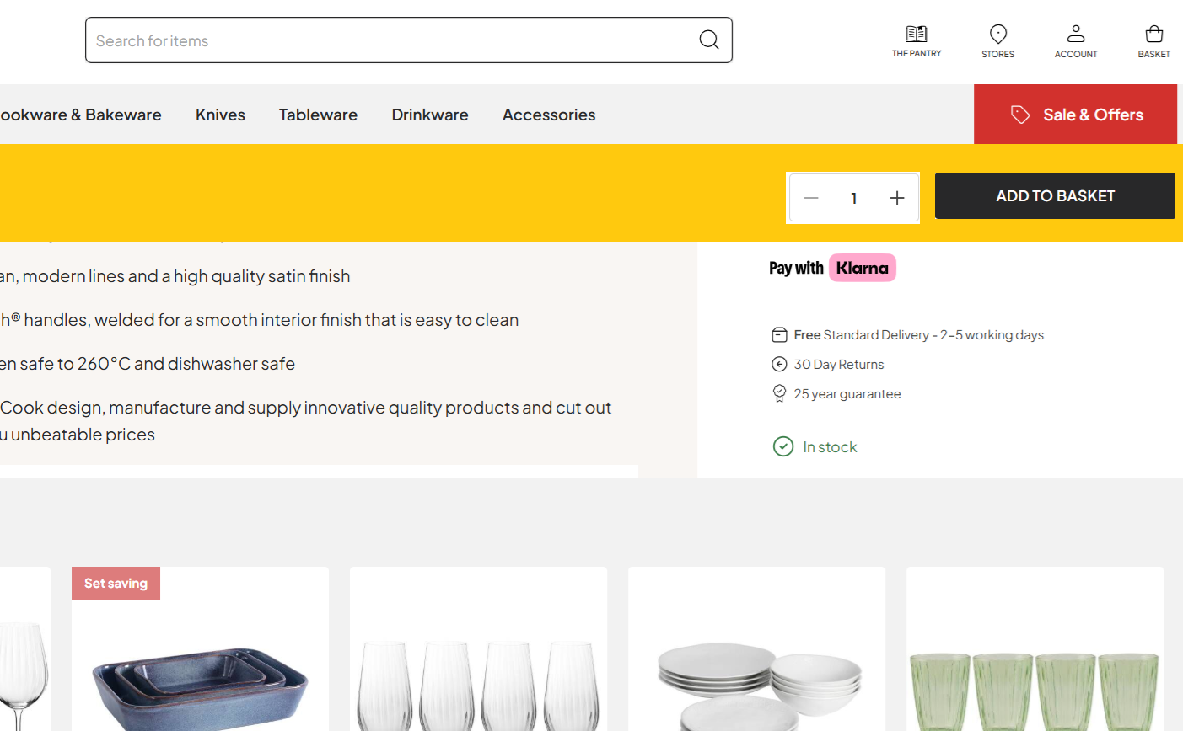
Sticky Add-to-Cart on PDP – Proposed Layout
View on Page Load View after Scrolling
ATC is visible
ATC is visible

Slide 8
Sticky Add-to-Cart on PDP – Hypothesis & Success metrics
Hypothesis
Making the add-to-cart CTA persistently visible on PDPs will increase add-to-cart conversion by reducing purchase friction, without negatively impacting user experience
Key metric
PDP visit to ATC conversion
Secondary metrics
PDP ATC to Order conversion
PDP Exit rate
PDP Scroll rate

Slide 9
Sticky Add-to-Cart on PDP – Test Design & Experiment Setup
Dimension |  | Description
Experiment Type |  | Randomized A/B test (Control vs Treatment)
Statistical Test |  | Two-proportion z-test
Variants | Control ( C ) | ATC visible on page load but scrolls out of view
 | Treatment ( T1 ) | Sticky ATC CTA while scrolling
Primary Metric |  | Add-to-Cart Conversion Rate
Randomization Unit |  | Session-level
Traffic Split |  | 50% Control / 50% Treatment
Test URL |  | www.thecompany.com/stainless_steel_pot/SKU-123.com
Test Duration |  | 14 days

Slide 10
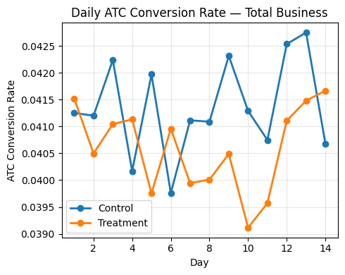
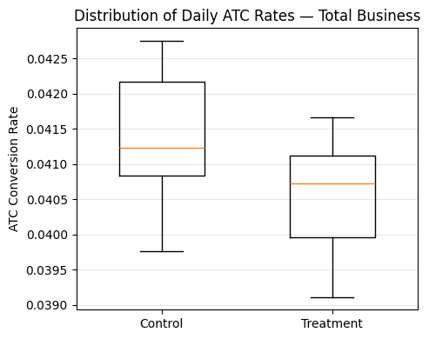
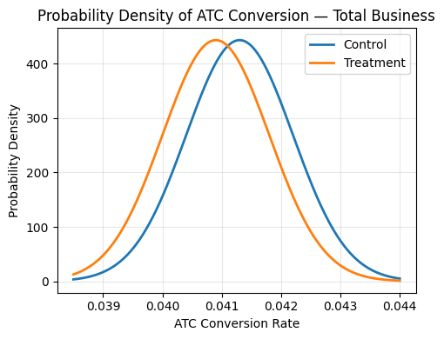
Sticky Add-to-Cart on PDP – Results
Variation | Visits | ATC Clicks | ATC rate | Improvement | Confidence Interval | p-value
Control | 32,812 | 1,354 | 4.13% | Baseline | Baseline | Baseline
Treatment 1 | 31,575 | 1,252 | 3.97% | -0.16 pp | [−0.34pp, +0.02pp] | 0.07
Total | 64,387 | 2,606 | 4.05%
While not statistically significant, Sticky ATC directionally underperformed Control

Slide 11
Sticky Add-to-Cart on PDP – Results
Device | Variation | Visits | ATC Clicks | ATC Rate | Improvement | Confidence Interval | p-value
Mobile | Control | 22,968 | 953 | 4.15% | Baseline | Baseline | Baseline
Mobile | Treatment 1 | 22,102 | 849 | 3.84% | −0.31 pp | [−0.55pp, −0.07pp] | 0.01
Mobile Total |  | 45,070 | 1,802 | 4.00%
Device | Variation | Visits | ATC Clicks | ATC Rate | Improvement | Confidence Interval | p-value
Desktop | Control | 9,844 | 401 | 4.07% | Baseline | Baseline | Baseline
Desktop | Treatment 1 | 9,473 | 403 | 4.27% | +0.20 pp | [−0.35pp, +0.75pp] | 0.31
Desktop Total |  | 19,317 | 804 | 4.16%
Sticky ATC delivered a small, non-significant uplift on Desktop but caused a statistically significant decline on mobile

Slide 12
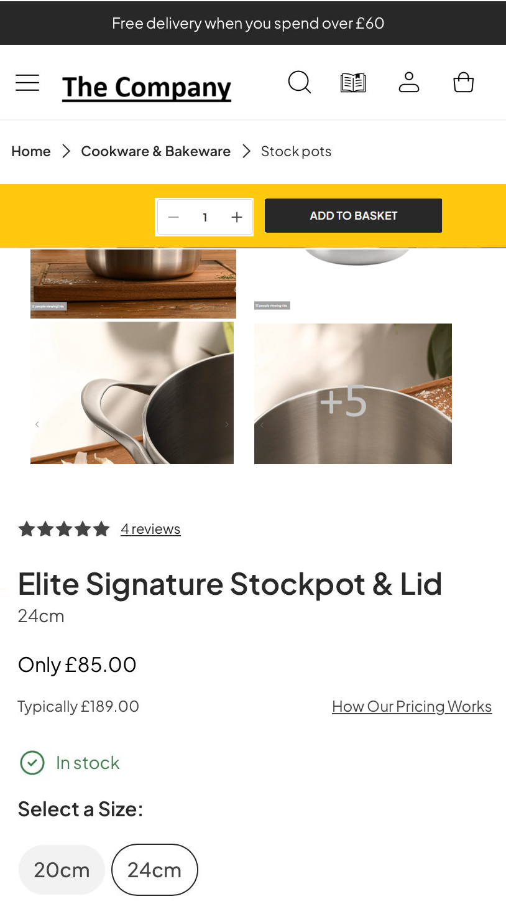
Sticky Add-to-Cart on PDP – Conclusions
While desktop users showed a small directional uplift, mobile users, who represent ~60% of traffic, experienced a significant decline in add-to-cart rate
On Mobile, users seem to value a clean, unobstructed PDP view. The persistent ATC reduced visual clarity and was likely perceived as intrusive or distracting
It is not recommended to roll out Sticky ATC globally. Prioritize mobile-first PDP clarity and explore alternative friction-reduction patterns that preserve content visibility.

Slide 13
Photo Grid improvement on PDP

Slide 14
Photo Grid improvement on PDP - Problem statement
Business context
PDP photo grid is one of the primary ways users evaluate quality, usage, and fit.
Low ATC rates suggest users may still lack clarity or confidence, highlighting an opportunity to strengthen product storytelling through imagery.
Leadership question
Can improving the PDP photo grid increase add-to-cart conversion by improving product understanding and customer confidence?
Decisions to be made
Should the layout of the PDP photo grid be changed?
Should specialty videos be added to the PDP photo grid?

Slide 15
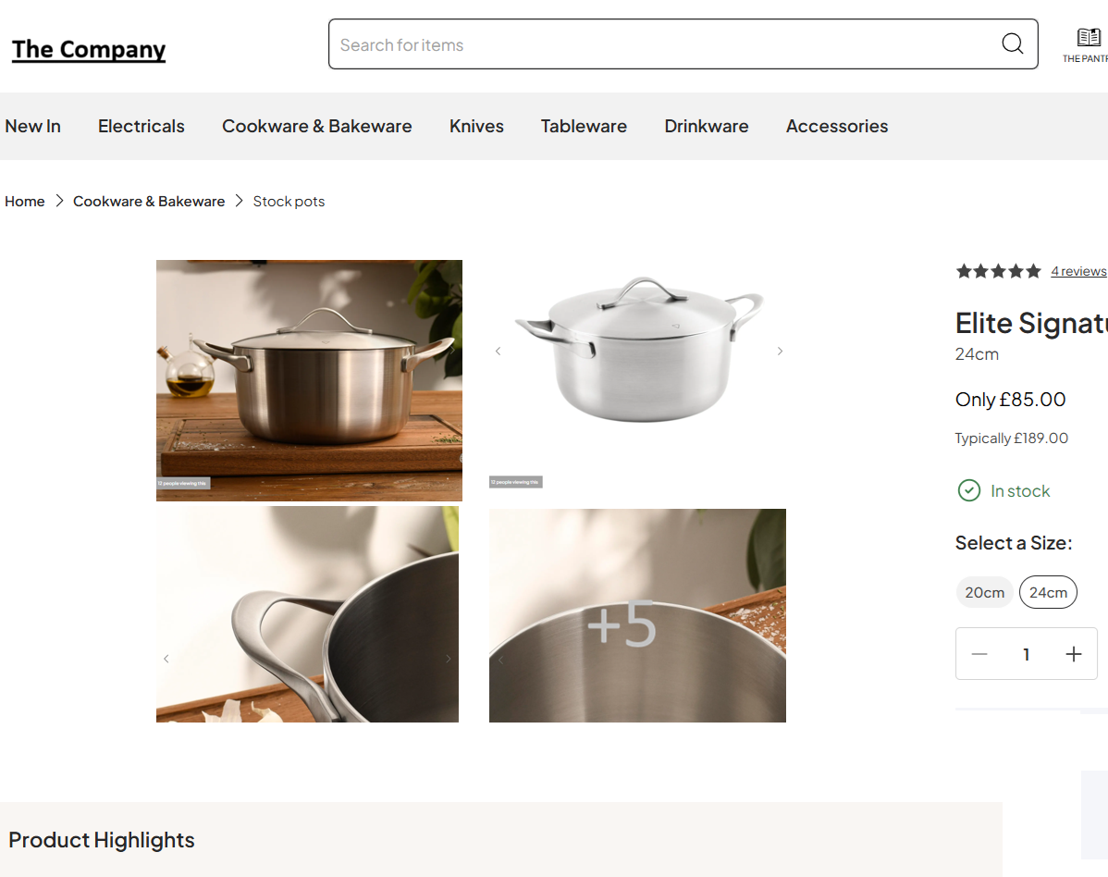
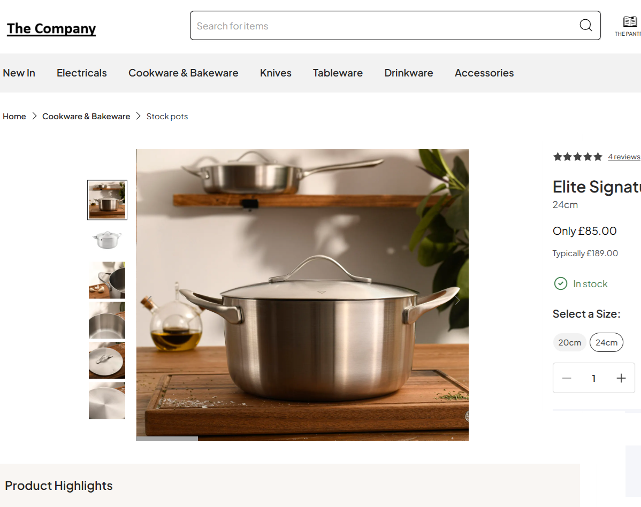
Photo Grid improvement on PDP – Layout
Current Layout Option A: Hero-first Photo Grid

Slide 16
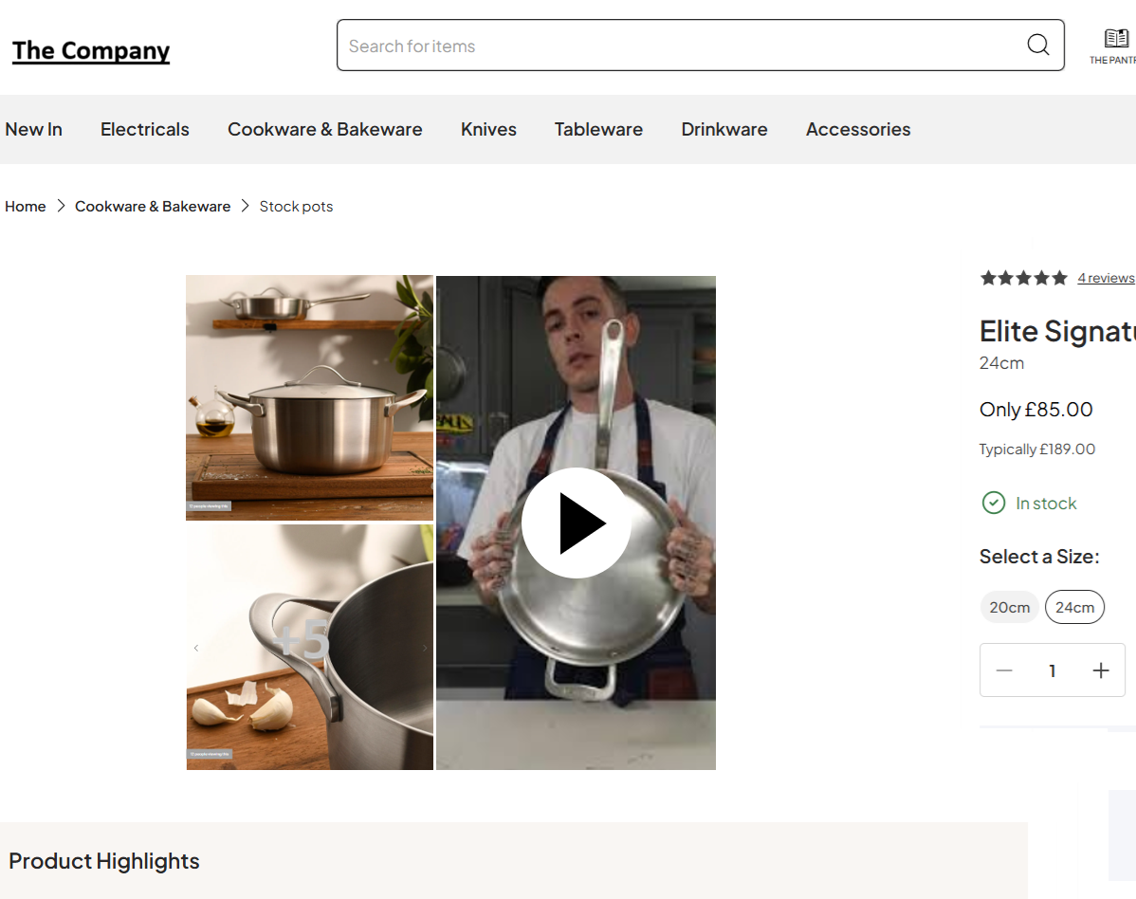
Photo Grid improvement on PDP – Layout
Current Layout Option B: Video-enhanced Photo Grid

Slide 17
Photo Grid improvement on PDP – Hypothesis & Success metrics
Hypothesis
Improving the PDP photo grid by enhancing visual hierarchy and incorporating rich media will increase add-to-cart conversion by improving product understanding and customer confidence
Key metric
PDP visit to ATC conversion
Secondary metrics
PDP ATC to Order conversion
PDP Photo Grid Click rate
PDP Page Load time

Slide 18
Photo Grid improvement on PDP – Test Design & Experiment Setup
Dimension |  | Description
Experiment Type |  | Randomized A/B/n test (3-arm): 1 Control + 2 Treatment variants
Statistical Test |  | Chi-square test to verify difference among Variants Pairwise two-proportion z-tests vs Control
Variants | Control ( C ) | Current Photo Grid
 | Treatment 1 ( T1 ) | Hero-first Photo Grid
 | Treatment 2 ( T2 ) | Video-enhanced Photo Grid
Primary Metric |  | Add-to-Cart Conversion Rate
Randomization Unit |  | Session-level
Traffic Split |  | Even split (33.33% each)
Test URL |  | www.thecompany.com/stainless_steel_pot/SKU-123.com
Test Duration |  | 14 days

Slide 19
Photo Grid improvement on PDP – Results
Variation | Visits | ATC Clicks | ATC rate | Improvement | Confidence Interval | p-value
Control (C) | 18,200 | 728 | 4.00% | Baseline | Baseline | Baseline
Hero-first (T1) | 18,050 | 836 | 4.63% | +0.63 pp | [+0.28pp, +0.98pp] | 0.002
Video (T2) | 18,120 | 765 | 4.22% | +0.22 pp | [-0.12pp, +0.56pp] | 0.18
Total | 54,370 | 2,329 | 4.28%
Hero-first Photo Grid shows a strong and significant lift in the add-to-cart conversion
Video-enhanced Photo Grid presents a non-statistically significant improvement on add-to-cart

Slide 20
Photo Grid improvement on PDP – Economic Impact
Metric | Baseline | Video-Enhanced
Monthly PDP visits | 300,000 | 300,000
Number of PDPs | 20,000 | 20,000
ATC rate | 4.00% | 4.22%
Add-to-Carts | 12,000 | 12,660
ATC → Order conversion | 20% | 20%
Orders | 2,400 | 2,532
Incremental orders | — | 132
Avg. Margin per order | $40 | $40
Monthly margin | $96,000 | $101,280
Incremental monthly margin | — | $5,280
Video production cost per PDP | — | $250
ROI assessment | — | Not economically viable at scale
Max Video rollout | — | 20 PDPs
Video-enhanced Photo Grid is not Economically viable at scale

Slide 21
Photo Grid improvement on PDP – Conclusions
Prioritizing the Hero image at first view led to a meaningful lift in add-to-cart, suggesting shoppers benefit from immediate product clarity before engaging with additional content
While Video-enhanced Photo Grid drove a modest directional lift in add-to-cart, the impact was not significant, suggesting video adds value for some shoppers only
The Video variant created incremental value, but not enough to justify scaling across all PDPs. Based on the observed lift, we can produce 20 videos per month and remain ROI-neutral

Slide 22
Next Steps
Explore alternative sticky ATC layouts that maintain visibility without crowding key content
Explore additional PDP optimizations like:
PWA-friendly environments,
Enhanced image resolution,
or AI-generated visuals for SKUs with limited photography
Test with placing ATC options in sections like “You May Also Like,” “Recently Viewed,” aiming to capture intent at different scroll depths and decision moments

Slide 23
Thank You!

